Slide 1
KASAGANA-KA Mutual Benefit Association, Inc.
YEAREND REPORT
2020

Slide 2
Plan for 2020 | Performance
1. Increase in members’ outreach to 60,000 | 52,902
2. Increase in revenue by 67.6M | 41.5M
3. Maintain a combined OPEX of 20% | 26%
4. Enforce an 8-hour claims settlement upon notification | ✓
5. Apply for Certificate of Tax Exemption | Deferred
6. Apply for a BIR registration of the KMBA KOINS | Deferred
7. Establish at least 1 consortium partner | ✗
8. Transfer of KSO institutions in the new KMBA building | ✓
9. Compliance of building licenses, documentations and requirements | ✓
10. Partner with other insurance providers for other insurance products
11. Conduct 14th Annual General Meeting | ✓
12. Participate in MiMap and ICMIF activities | ✓

Slide 3
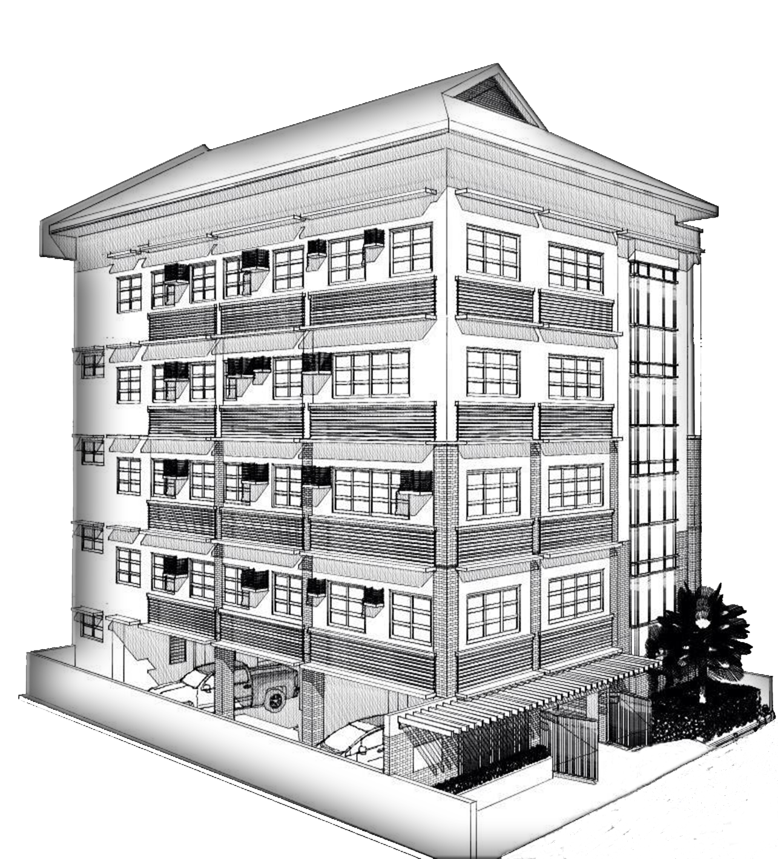
Assets
P 238.2M
Members
52,902
Retirement
Savings Fund
P 57.6 M
Premium
P 369.5M
Staff
12
Claims
P 67M
Notes:
Red text, hindi yan ang amount, nilagay ko lang

Slide 4
Assets
P 238.18 M
1.01% higher than target of P236.4 M.
6.5% or P14.62 M increase from 2019
8% average annual growth since 2017

Slide 5
Liabilities
P 164.33 M
1.6% higher than target of P161.7 M.
10.6% or P15.7 M increase from 2019
11% average annual growth since 2017

Slide 6
Fund Balance
P 73.85 M
1.14% lower than target of P74.7 M.
1.5% or P1.1 M decrease from 2019
1% average annual growth since 2017

Slide 7
Surplus
P 0.93M deficit in 2020 was due to the impact of Covid19 pandemic

Slide 8
Membership
52,902
35,405
1,675
Total membership
856
Other groups
14,996

Slide 9
Membership
Grace period granted to lapse accounts
20,598
19,313
12,490
9,526
March 2020
July 2020
November 2020
Grace period extended up to 106 days
Grace period extended to 60 days as mandated by Bayanihan Act 2020
Notes:
Number of lapsed members po ito

Slide 10
Membership
Member
Spouse/Common Law
Children
52,902
9,520
106,912
Total = 169,334
Notes:
52,902 – KMBA’s declared total members; 9,520 are captured data ng system na bilang ng member with encoded spouse or common law; 106,912 are number of children encoded in the system. May bilang po ng member’s civil status (next slide)

Slide 11
Membership
Civil Status
Single | 18,639
Married / Common law | 29,610
Separated | 972
Widow | 1,901
Unrecorded | 1,780
Notes:
Sa mga nagdeclare na sila ay married/may kinakasama pero walang isinulat o hindi naencode and asawa sa system, hindi po yun nabilang sa unang slide na spouse.
Ang mga may civil status na separated or widow pero may nakaencode sa system na name ng asawa, binilang po yun ng system sa previous slide.
May mga member po na walang inencode na civil status kaya wala sila sa bilang.

Slide 12
Membership
 | Total
New | 5,666
Resigned | 11,370

Slide 13
Resigned
Notes:
Idagdag ang resignation 2020, starting 2017, nasa koins na ang data ng resignation

Slide 14
Claims Process
Manual claims processing
Online claims processing
2020
2019
2021
January
March 16
September
December
Check disbursement
Claims pay-out via remittance payment centers/bank accounts/GCash
Approvals done via KOINS and pay-out directly to beneficiary’s account

Slide 15
Claims
Organization | Number | Amount
CAPS-R | 119 | 2,299,443.70
JVOMFI | 3 | 70,000.00
KCOOP | 417 | 8,585,702.12
OTHER ASSOCIATES | 8 | 131,939.97
Grand Total | 547 | 11,087,085.79

Slide 16
Claims
Notes:
Remove gender

Slide 17
Claims
Number of claims
Amount of claims
Notes:
BLIP claims only
CLIP and HIIP not included
Graphs cant be merged into one, since variables are not the same

Slide 18
Claims
Claims Age Groups
Notes:
Age of deceased

Slide 19
Claims
1
2
3

Slide 20
Claims

Slide 21
Exit Age
P 2.7M released to exit age members since 2017.
Total of 458 members

Slide 22
CLIP
32%
Covered loans
80,992
Premium
P 7,266,485
Claims
P 2,350,083

Slide 23
CLIP
Premium
P 7,266,485
80,992 loans
Claims
P 2,350,083
32%
Notes:
Ratio of CLIP Claims / Premium

Slide 24
HIIP
Claims
P 89,200
Premium Enrolled
P 1,129,250 4,515

Slide 25
HIIP
Premium
1,129,250
Enrolled
4,515
Claims
P 89,200

Slide 26
K-Bente
Enrolled | 73,286
Premium | P 1,465,720
Claims | P 155,000
Notes:
52,820 = initial list submitted by aljon to Firstlife. Ongoing parin ang pag-confirm ng Caps-R kung active pa ang mga members nila na nakasama sa list. Wala pa itong premium payment
Estimate ang premium payment based sa bilang na nasa list.

Slide 27
K-Bente
73,286
Claims
Enrolled
P 155,000
P 1,465,720
Premium
Notes:
52,820 = initial list submitted by aljon to Firstlife. Ongoing parin ang pag-confirm ng Caps-R kung active pa ang mga members nila na nakasama sa list. Wala pa itong premium payment
Estimate ang premium payment based sa bilang na nasa list.

Slide 28
K-Kalinga
Enrollment
7,338
Claims
17
P 366,900
P 170,000

Slide 29
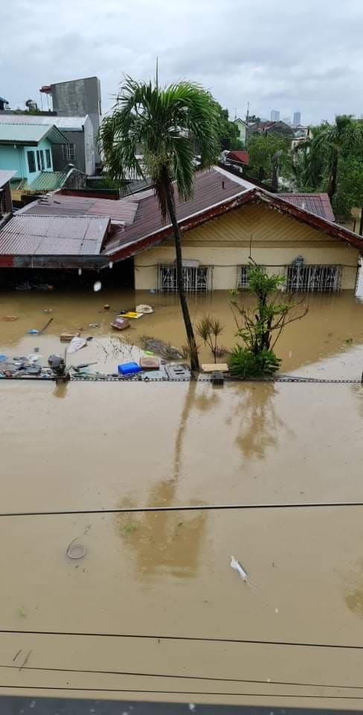
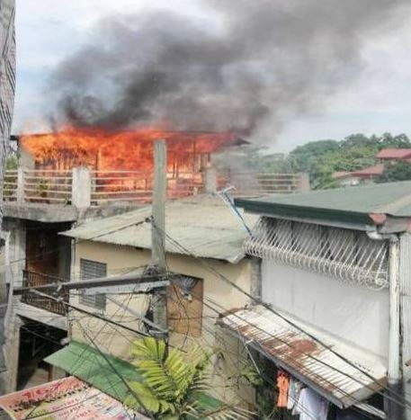
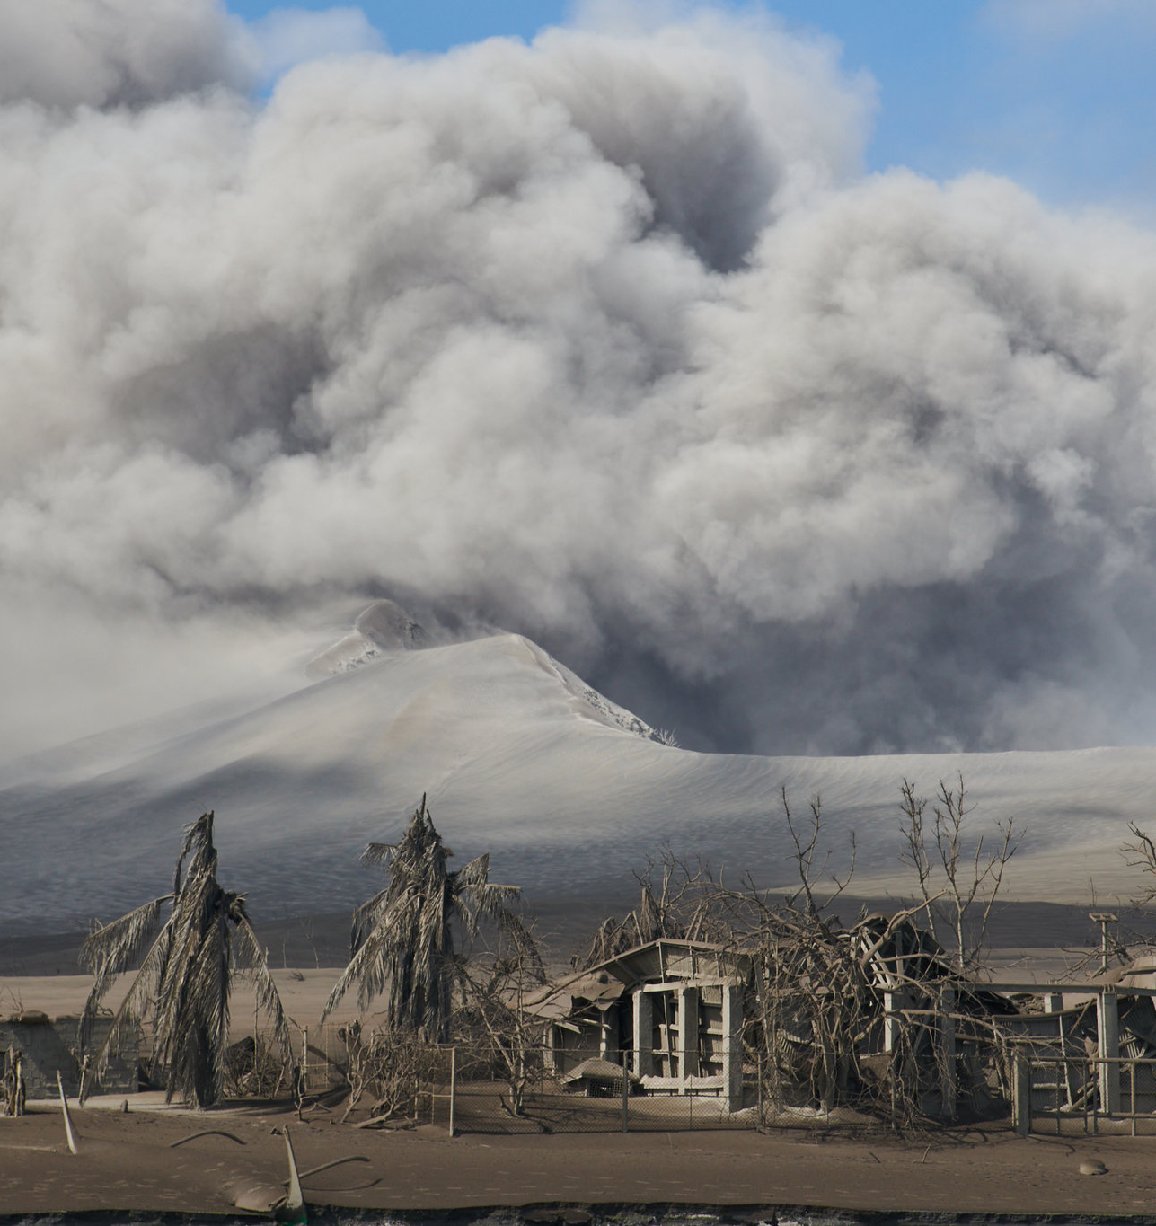
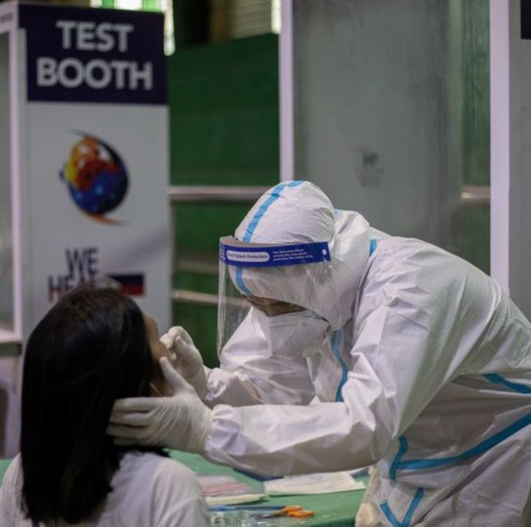
Calamity Assistance
Typhoon related
P 490,000
Fire related
P 171,000
Volcano eruption
P 25,000
Pandemic related
P 22,950

Slide 30
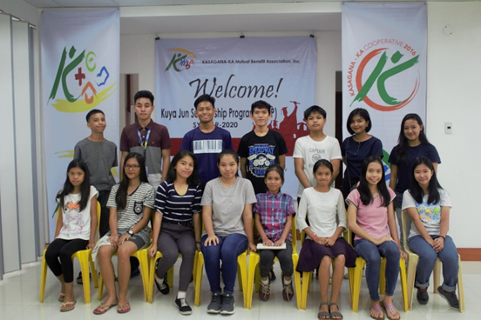
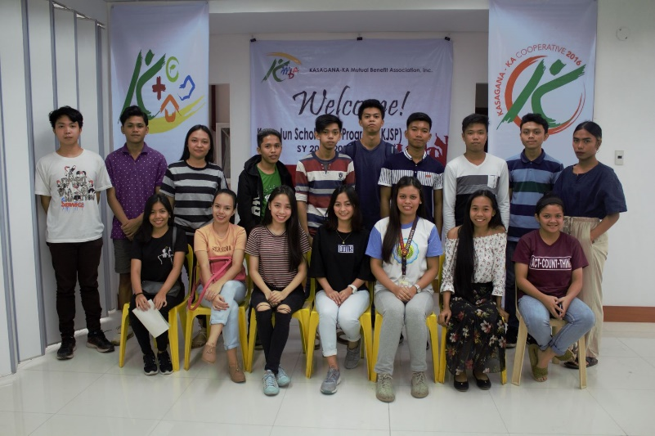
KJSP
High School
80
35
115
College

Slide 31
KJSP
High School
College
Total number of scholars from 2007
222
171
Total number of graduates
126
96
Total number dropouts from program
16
40
Current active scholars
80
35
Total amount of benefit: P 5,504,490

Slide 32
KJSP
Top five (5) college courses taken by scholars
1. Business Administration
2. Education
3. Information Technology
4. Engineering
5. Accountancy

Slide 33
Reinsurance

Slide 34
Affiliations

Slide 35
Compliance
Committed to uphold and strengthen good governance principles in the operation. Up-to-date compliance to -
Anti-Money Laundering Council
BIR
SEC
DOLE
IC
Network

Slide 36
Network
Active participant of network-initiated investment pool and activities.
BPI Bayanihan Fund (UITF)
Mutual Guarantee Fund

Slide 37
KMBA was among the recipients of the ASEAN Corporate Governance Scorecard (ACGS) Golden Arrow Awards, held virtually last February 19, 2021

Slide 38
Priorities for 2021
1. Increase in member’s outreach by 20% or up to 60,000
2. Increase in revenue by 20% or Php 64.9M
3. Maintain a combined OPEX of 15%
4. Enhancement of BLIP vis-à-vis EV utilization
5. Implement online claims transactions
6. Prepare documentations for Tax Exemption
7. Prepare for the implementation of IFRS17
8. Improve IEC materials for marketing purposes
9. Update Facebook and website regularly
10. Explore other group segments like transport delivery services
11. Conduct of 15th Annual General Meeting
12. Strengthen links for both national and international networks

Slide 39
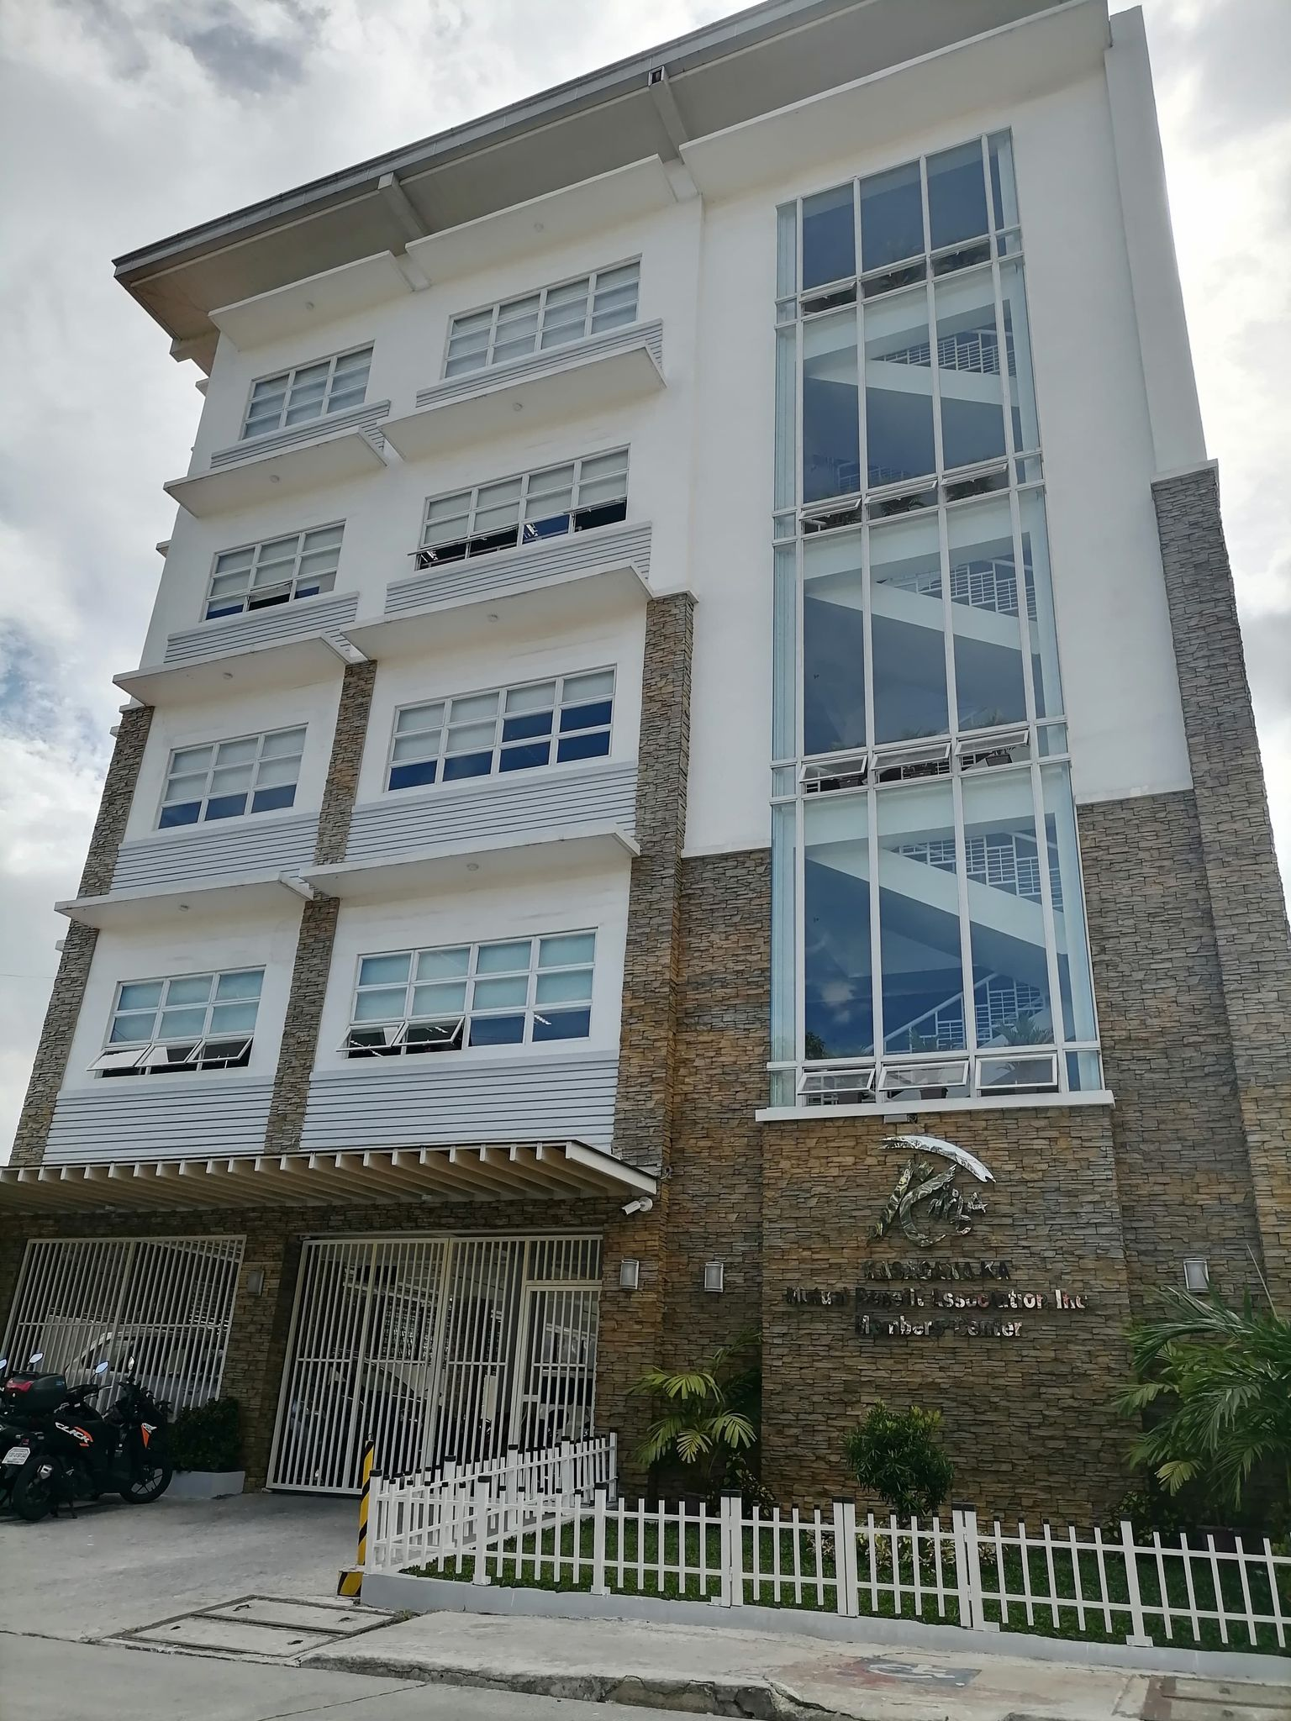
Visit us at:
5 Matimpiin St., Bgy. Pinyahan, QC.
Contact No.: (02) 8799-55-18
Email Add: kasaganaka.mba@gmail.com
Website: www.kmba.org.ph
FB: www.facebook.com/kmbapage

Slide 40
Thank you!

